Slide 1
Exam Preparation
Telerik Software Academy
Learning & Development
http://academy.telerik.com

Slide 2
Task 1 – Web Control with Vanilla JavaScript

Slide 3
Task 1 – Web Control with Vanilla JavaScript
Create a calendar using pure (vanilla) JavaScript
Given the HTML file (index.html) create a JavaScript function called createCalendar(selector, events)
selector is a string object that contains a DOM selector ('.class', '#id', '#parent .item')
Events is an array of objects, following the structure:
Events should be added into the 'day box' for the day in the event.day property
var events = [{
title: 'JavaScript UI & DOM exam", //a regular string
date: 17, //a number between 1 and 30 inclusive
time: '10:00', //a string in the format "HH:MM"
duration: 360 //a positive number less than 1440 }, { //(24 hours * 60 minutes)
…
}];

Slide 4
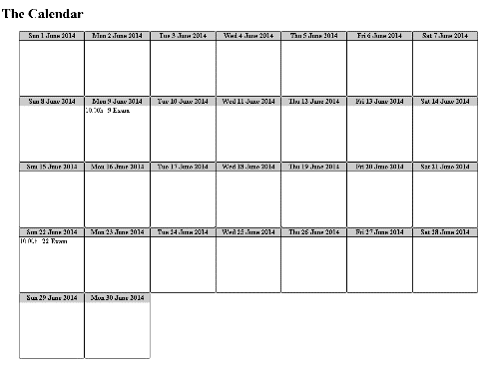
Task 1 – Web Control with Vanilla JavaScript (2)
(cont) Create a calendar using pure (vanilla) JavaScript
The createCalendar() function should add the calendar into the control given as selector
As a result you should produce the following HTML
Constraints:
No CSS allowed, all the styles should be applied with JavaScript
The calendar is always for June 2014
There will be no more than a single event for a date

Slide 5
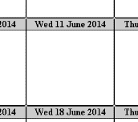
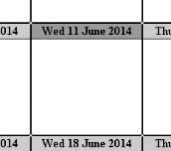
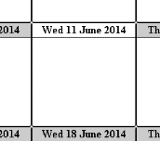
Task 1 – Web Control with Vanilla JavaScript (3)
(cont) Create a calendar using pure (vanilla) JavaScript
The calendar should support the following functionality:
Hover on a day changes the background of the title
Click on a day changes the color of the whole day element
Only one element can be selected at once
Example:
Normal
Hovered
Selected

Slide 6
Task 2 – jQuery plugin

Slide 7
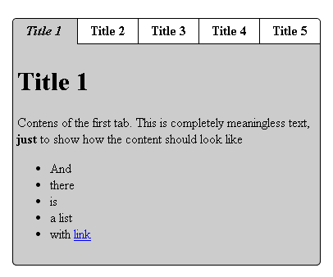
Task 2 – jQuery Plugin
Create a tabs control using jQuery and wrap it into a plugin
Your are given HTML code in the index.html file
And a CSS file, that you must use
Using your plugin, transform the HTML into a tabs control like the following:
Using:
$('#tabs-container').tabs();

Slide 8
Task 3 – Handlebars Templates

Slide 9
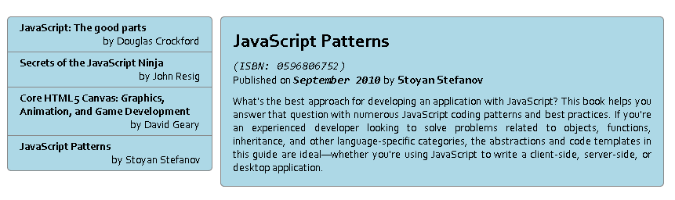
Task 3 – Handlebars Templates
Given the HTML (index.html), CSS (styles.css) and JavaScript (scripts.js) build a template that produces the HTML in result.html
You should only fill the templates in the elements with ids 'books-list-template' and 'book-details-template'

